Slide 1
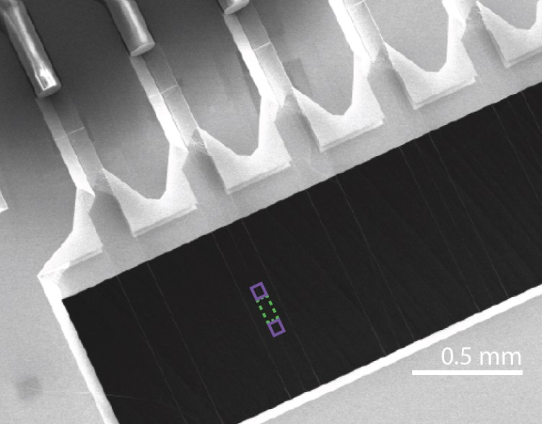
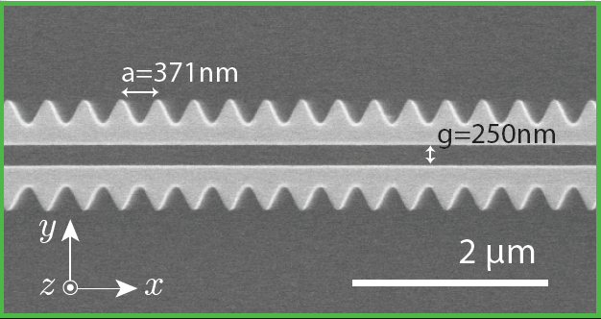





Creating long-range nonlinear optical interactions with cold atoms coupled to photonic crystals
Darrick Chang
ICFO – The Institute of Photonic Sciences
Barcelona, Spain
Summer School on Quantum and Nonlinear Optics
June 9, 2015

Slide 2
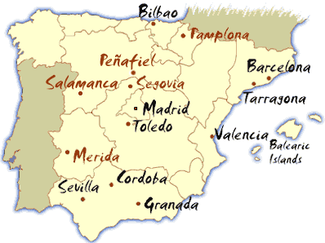
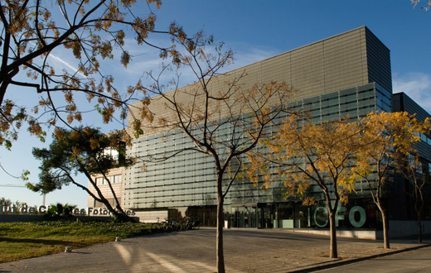

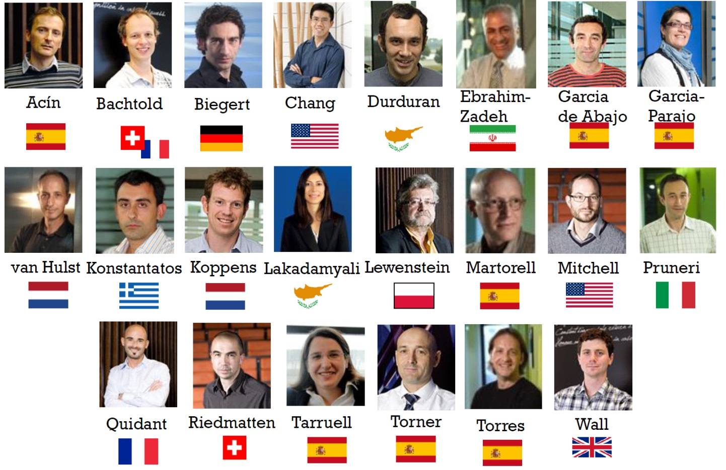
ICFO – The Institute of Photonic Sciences
10 minute walk
Research themes:
Quantum optics
Nanophotonics
Nonlinear optics
Medical optics

Slide 3
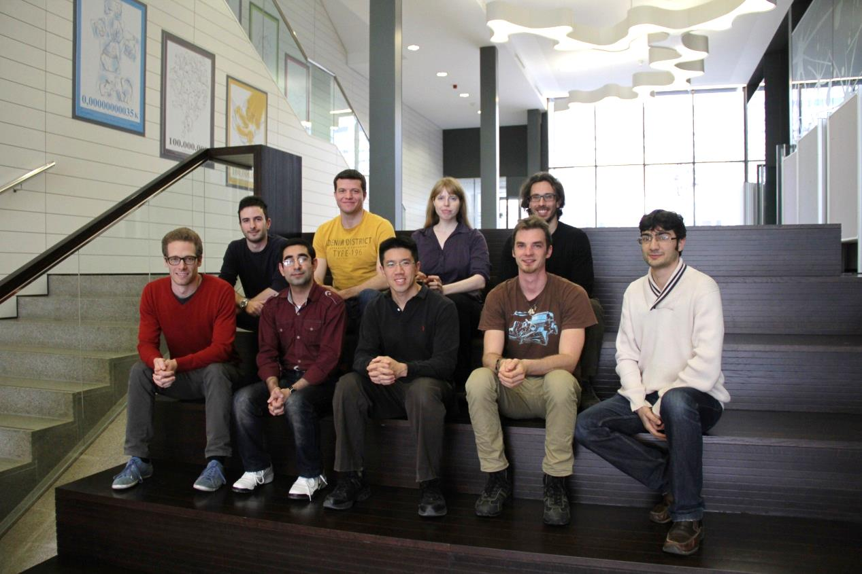

My group
Theoretical Quantum Nanophotonics Group
Marinko
Jablan
Christine
Muschik
Tommaso
Caneva
Marco
Manzoni
Ana Asenjo
James
Douglas
Mousa
Bahrami
Darrick
Chang
Lukas
Neumeier
Hessam
Habibian
Also thanks to: Jeff Kimble (Caltech), Alexey Gorshkov (JQI)

Slide 4
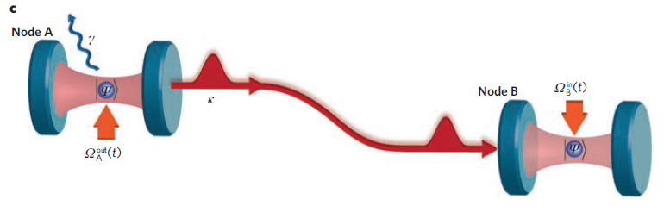
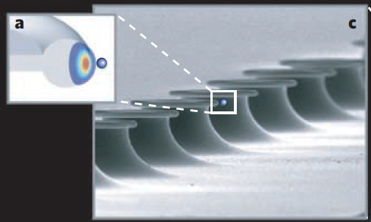
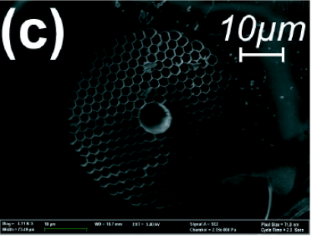
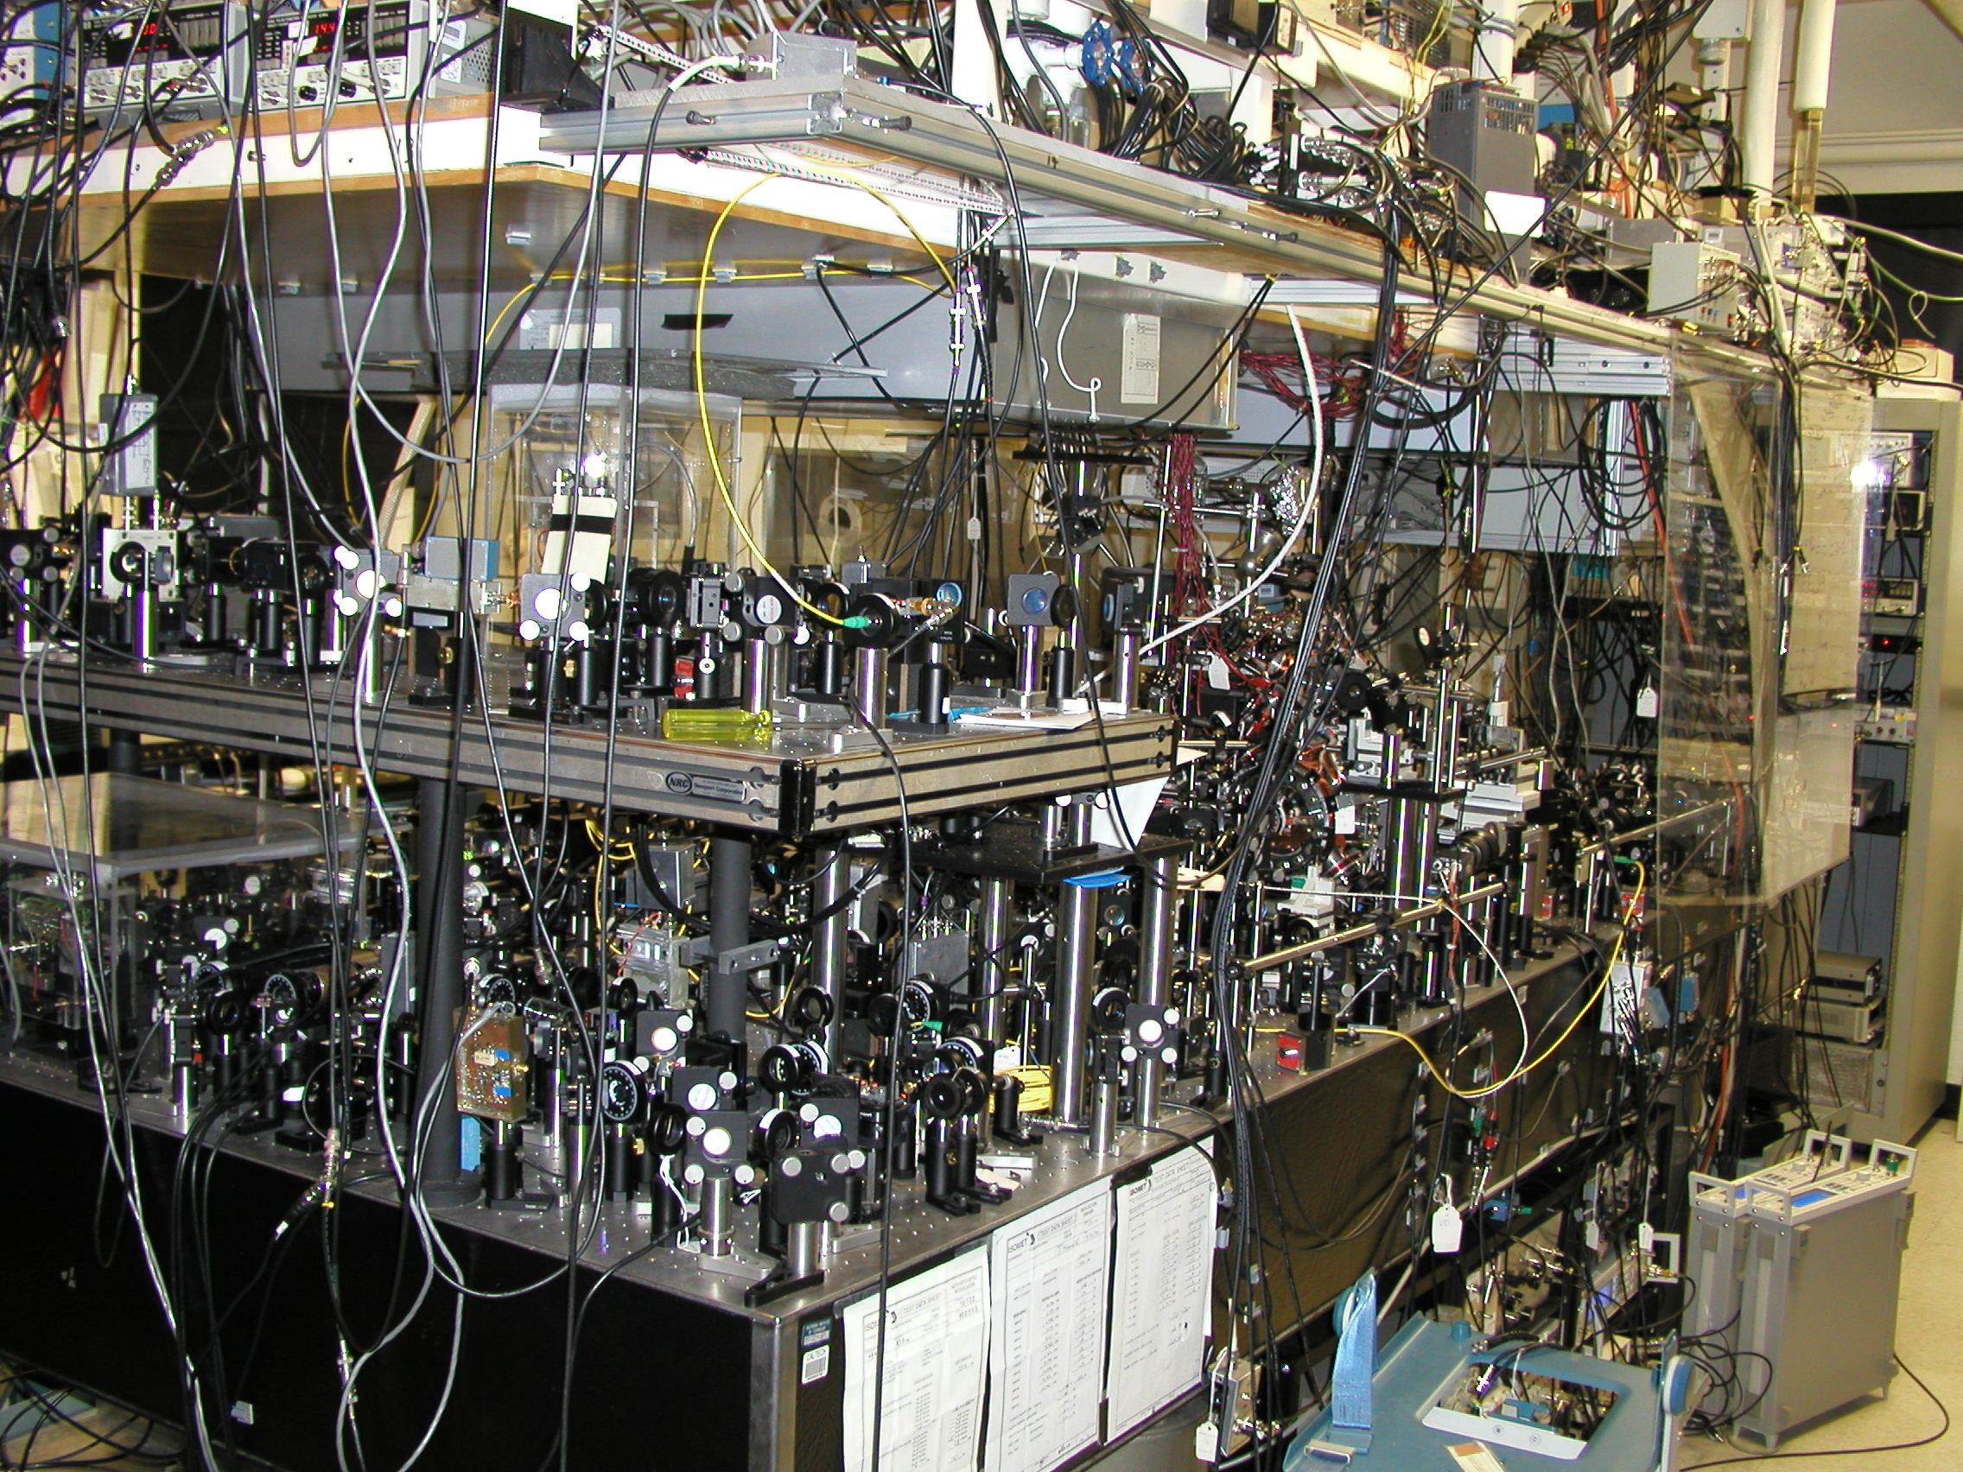
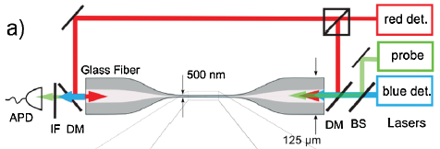
Toward an atom-nanophotonics interface
Goal: building blocks for complex quantum systems/devices
  Atoms provide quantum functionality, photonics provide control and scalability
Review: HJ Kimble, “The quantum internet,” Nature (2008)
Expt: Rempe (MPQ), Nature (2012)
Vahala, Kimble (Caltech)
Lukin (Harvard),
Vuletic (MIT)
Image from Kimble group
Rauschenbeutel (Vienna)

Slide 5
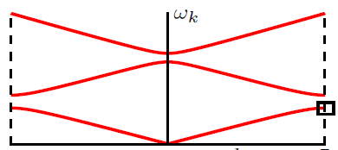









Photonic crystals
Normal fiber: light guided by total internal reflection
$$ω(k)$$
$$\frac{ω}{k}=\frac{c}{n}$$
$$n_{core}$$
$$n_{cladding}<n_{core}$$
Single defect: scattering
$$k$$
Periodic defects: band structure
$$a$$
$$ω(k)$$
Control over dispersion / spatial modes
Band gaps – forbidden propagation
$$k$$
$$\frac{π}{a}$$

Slide 6
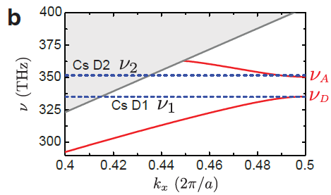
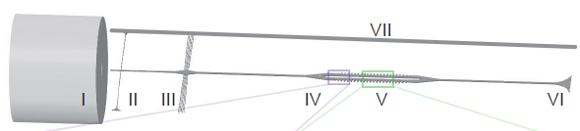
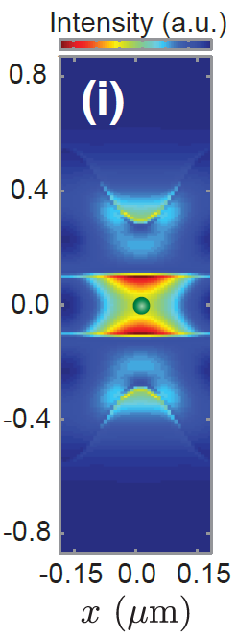


Overview of PhC-atom experiment
Integrated and suspended “alligator” PhC waveguide
Schematic of device
Band engineering
trapping
MOT
physics
Alligator PhC region
Physics band
Efficient photon-atom interaction on resonance
$$P∼0.5$$
A. Goban et al., Nature Commun. 5, 3808 (2014) (Kimble, Caltech)
(also similar expts. in Lukin group at Harvard)
($P∼0.05$ in nanofibers)

Slide 7
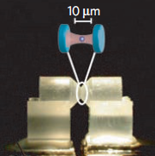




What’s next?
Does nanophotonics just enable us to do old things better?
Jaynes-Cummings model
$$≈$$
$$≈$$
OR
New paradigms
Quantum information processing
Single-photon nonlinear optics
Many-body physics
Atom trapping

Slide 8
What’s next?
Does nanophotonics just enable us to do old things better?
Jaynes-Cummings model
$$≈$$
$$≈$$
OR
Surface & vacuum forces
Large per-photon forces
Dimensionality & dispersion
Strong atom-photon interactions
New paradigms
Quantum information processing
Single-photon nonlinear optics
Many-body physics
Atom trapping

Slide 9
Many-body physics: engineering long-range interactions between atoms

Slide 10
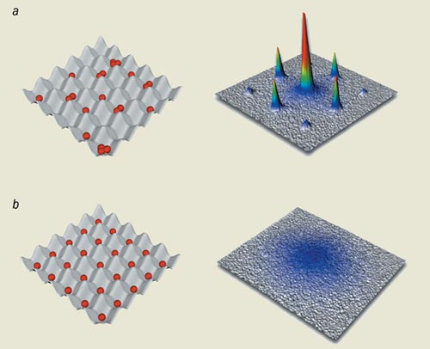
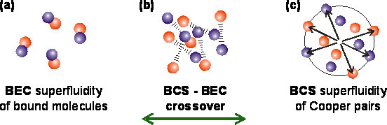


Motivation: quantum simulation
Tremendous progress in observing quantum many-body phenomena using ultracold atoms
BEC-BCS crossover
Superfluid-Mott insulator transition
One limitation: types of interactions
  Atoms are neutral point particles
$$U$$
$$?$$

Slide 11
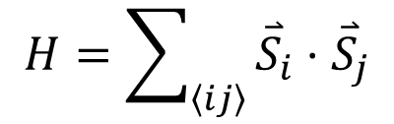
Engineering long-range interactions
Rich phenomena associated with interactions:
  Beyond nearest neighbor: frustration in quantum magnetism
?
$$H=\sum_{\left\langle ij\right\rangle }{{\overset{⃑}{S}}_{i}⋅{\overset{⃑}{S}}_{j}}$$

Slide 12

Engineering long-range interactions
Rich phenomena associated with interactions:
  Beyond nearest neighbor: frustration in quantum magnetism
$$H=∑{\overset{⃑}{S}}_{i}⋅{\overset{⃑}{S}}_{i+1}$$

Slide 13
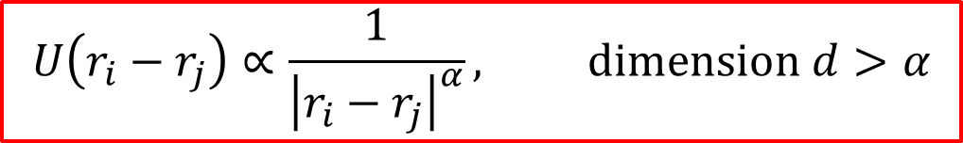

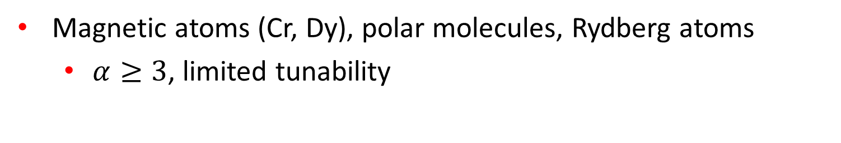
Engineering long-range interactions
Rich phenomena associated with interactions:
  Beyond nearest neighbor: frustration in quantum magnetism
  New phases of degenerate quantum matter (e.g., supersolids)
  Long-range: non-additivity, breakdown of quantum “speed limits” (Lieb-Robinson bounds)
?
$$H=∑{\overset{⃑}{S}}_{i}⋅{\overset{⃑}{S}}_{i+1}+{\overset{⃑}{S}}_{i}⋅{\overset{⃑}{S}}_{i+2}$$
$$U\left(r_{i}−r_{j}\right)∝\frac{1}{{\left|r_{i}−r_{j}\right|}^{α}}, dimension d>α$$
Expts with ions: Blatt (Innsbruck), Monroe (JQI) (2014)
Magnetic atoms (Cr, Dy), polar molecules, Rydberg atoms
  $α≥3$, limited tunability
True tunable, long-range interactions?

Slide 14





Light-mediated interactions
Infinite-range interactions are “easy” with light
Cavity QED:
$$|e,0〉$$
$$g$$
$$|g,1〉$$
$$Δ=ω_{cavity}−ω_{atom}$$
Dressed state
$$|ψ〉=\cos{θ}|e〉+\sin{θ}|1〉≈|e〉+\frac{g}{Δ}|1〉$$

Slide 15







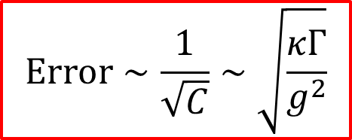
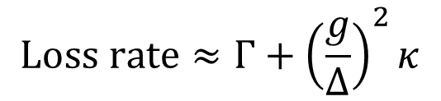

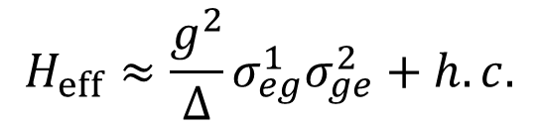
Light-mediated interactions
Infinite-range interactions are “easy” with light
Cavity QED:
$$Γ$$
$$|e_{1},0〉$$
$$|e_{2},0〉$$
$$g$$
$$g$$
$$κ$$
$$|g_{1},1〉$$
$$|g_{2},1〉$$
Second atom: absorbs photonic component of first dressed atom
$$H_{eff}≈\frac{g^{2}}{Δ}σ_{eg}^{1}σ_{ge}^{2}+h.c.$$
Optimize exchange probability via detuning
$$Error∼\frac{1}{\sqrt{C}}∼\sqrt{\frac{κΓ}{g^{2}}}$$
$$Loss rate≈Γ+{\left(\frac{g}{Δ}\right)}^{2}κ$$

Slide 16
Cavity QED
(Mostly) coherent dynamics
Infinite-range interactions
  All atoms between the cavity mirrors interact
Range not tunable
Infinite-range interactions are an “aberrant” case
  Well-solved by collective operators or mean-field
Also compare to normal waveguide:
$$H_{eff}=\frac{Γ_{1D}}{2}\sum_{all pairs}{σ_{eg}^{i}σ_{ge}^{j}\sin\left(k_{0}\left|z_{i}−z_{j}\right|\right)−}\frac{{iΓ}_{1D}}{2}\sum_{all pairs}{σ_{eg}^{i}σ_{ge}^{j}\cos\left(k_{0}\left|z_{i}−z_{j}\right|\right)}$$
Infinite-range, and equal strength coherent and dissipative terms

Slide 17








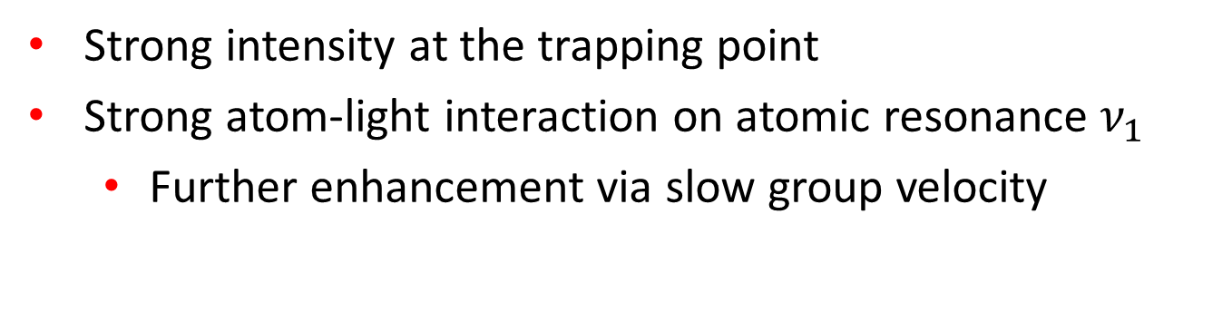






Dynamic “atom-induced cavity”
Initial work: S. John (Toronto) in 1990’s
Excited atom dressed by photonic “cloud” in the bandgap
$$ω$$
$$ω_{c}$$
$$|ψ_{c}〉=\cos{θ}|e〉+\sin{θ}|1〉$$
$$|e〉$$
$$ω_{a}$$
$$ω_{a}$$
$$ω_{b}$$
$$|g〉$$
Localized around atom
$$k$$
Atom-cavity properties:
$$ω_{c}$$
$$ω_{k}$$
$$ω_{a}$$
$$Δ>0$$
$$ω_{b}$$
Atom-like
$$k$$

Slide 18


Dynamic “atom-induced cavity”
Initial work: S. John (Toronto) in 1990’s
Excited atom dressed by photonic “cloud” in the bandgap
$$ω$$
$$ω_{c}$$
$$|ψ_{c}〉=\cos{θ}|e〉+\sin{θ}|1〉$$
$$|e〉$$
$$ω_{a}$$
$$ω_{a}$$
$$ω_{b}$$
$$|g〉$$
Localized around atom
$$k$$
Atom-cavity properties:
$$ω_{k}$$
$$ω_{c}$$
$$ω_{a}$$
$$ω_{b}$$
$$k$$

Slide 19

Dynamic “atom-induced cavity”
Initial work: S. John (Toronto) in 1990’s
Excited atom dressed by photonic “cloud” in the bandgap
$$ω$$
$$ω_{c}$$
$$|ψ_{c}〉=\cos{θ}|e〉+\sin{θ}|1〉$$
$$|e〉$$
$$ω_{a}$$
$$ω_{a}$$
$$ω_{b}$$
$$|g〉$$
Localized around atom
$$k$$
Atom-cavity properties:
$$ω_{k}$$
$$ω_{c}$$
$$ω_{b}$$
$$ω_{a}$$
Photon-like
$$k$$
Arbitrarily weak dielectric defect can create a cavity mode (1D)

Slide 20



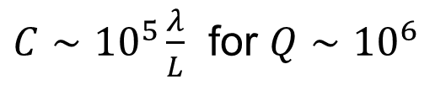
Long-range interactions
Photonic cloud has all the same functionality as a real cavity of the same size
  But centered around the atom, and follows it around!
$$L$$
Long-range dipole-dipole interactions
$$H_{eff}≈U\left(r_{1}−r_{2}\right)σ_{eg}^{1}σ_{ge}^{2}+h.c.$$
$\frac{U_{max}}{2π}∼10$ GHz for $L∼λ$
Same loss mechanisms as a real cavity
$C∼{10}^{5}\frac{λ}{L}$ for $Q∼{10}^{6}$
Apply toolbox of atomic physics to engineer interactions
  Ground-state manifold, external pump fields, time dependence …

Slide 21
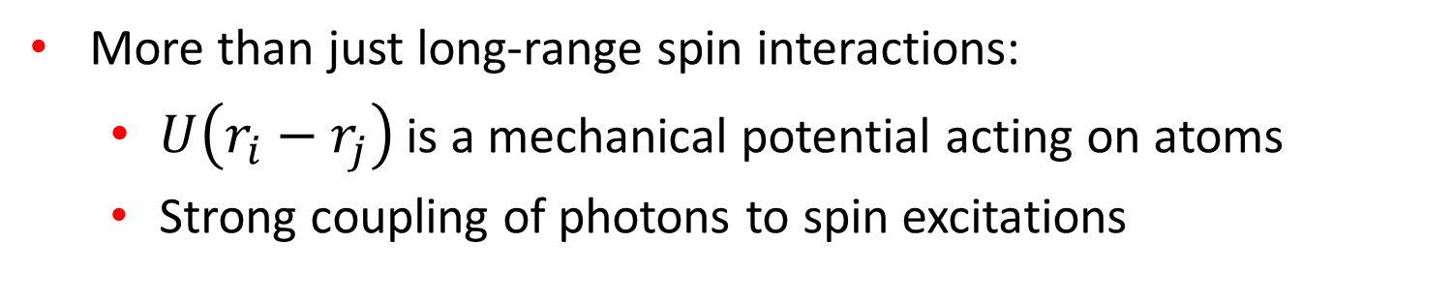
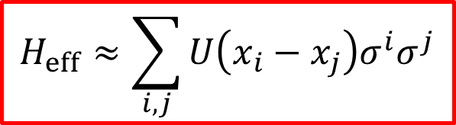
Strong multi-physics coupling
$$H_{eff}≈\sum_{i,j}{U\left(x_{i}−x_{j}\right)σ_{}^{i}σ_{}^{j}}$$
More than just long-range spin interactions:
  $U\left(r_{i}−r_{j}\right)$ is a mechanical potential acting on atoms
  Strong coupling of photons to spin excitations
An exciting quantum material
Spins
Long-range
Photons
Phonons

Slide 22
Engineering long-range interactions between photons

Slide 23
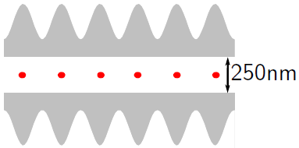





Long-range photonic interactions
Exploit simultaneous long-range interactions between spins, and strong spin-photon coupling
$$|e〉$$
$$|e〉$$
$$|g〉$$
$$|g〉$$
Physical system:
$$ω_{atom}$$
waveguide
Bandgap – Long-range atomic interactions

Slide 24
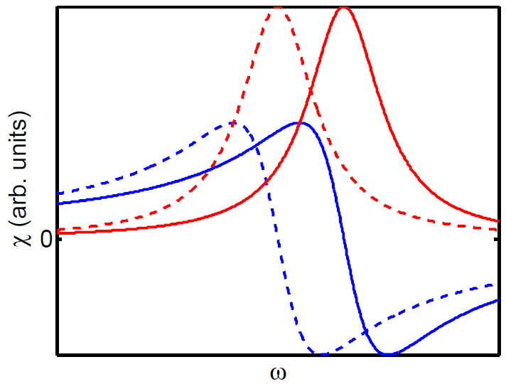

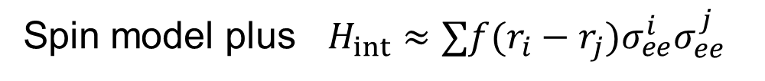
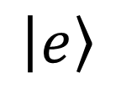
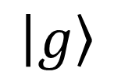
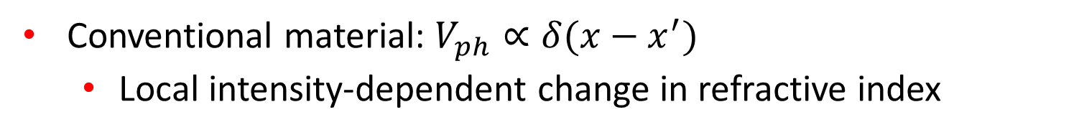
Long-range photonic interactions
Intuition: nonlinear, long-range changes in the refractive index
Spin model plus $H_{int}≈∑f(r_{i}−r_{j})σ_{ee}^{i}σ_{ee}^{j}$
w/o photon
w/photon
$$|e〉$$
$$|g〉$$
$$n\left(x\right)=∫dx^{′}V_{ph}\left(x,x^{′}\right){\left|E\left(x^{′}\right)\right|}^{2}$$
Conventional material: $V_{ph}∝δ(x−x^{′})$
  Local intensity-dependent change in refractive index

Slide 25
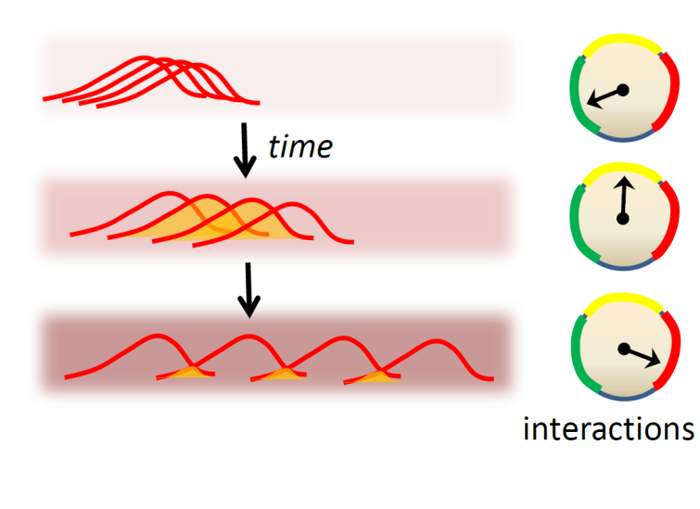

Why is it interesting?
New paradigm: building up quantum states of light from many-body dynamics
Challenging theoretical problem:
  Long-range, out-of-equilibrium, open system
  Generally unknown map between spin and photon interactions
$$f_{spin}\left(r_{1}−r_{2}\right)≠V_{photon}(r_{1}−r_{2})$$
  Beyond two-body photonic interactions

Slide 26



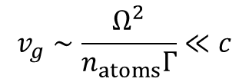




Electromagnetically induced transparency
Two-level atoms: strong absorption and group velocity dispersion near resonance
$$|e〉$$
$$E_{ω}$$
$$|g〉$$
Three-level atoms + EIT: minimal absorption and group velocity dispersion
$$|e〉$$
$$Ω$$
$$E_{ω}$$
$$|g〉$$
$$v_{g}∼\frac{Ω^{2}}{n_{atoms}Γ}≪c$$
$$|s〉$$
Dark state on two-photon resonance
$$|D〉∼Ω|g〉−E|s〉$$

Slide 27
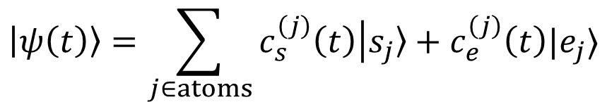

EIT dynamics from spin model
Does our spin model correctly predict EIT transparency and slow group velocity?
Numerically evaluate dynamics in one-excitation manifold:
$$|ψ\left(t\right)〉=\sum_{j∈atoms}{c_{s}^{\left(j\right)}\left(t\right)|s_{j}〉+c_{e}^{\left(j\right)}\left(t\right)|e_{j}〉}$$
  Initialize $c_{s}^{\left(j\right)}(0)$ as a Gaussian wavepacket (blue)
Dynamics: spin population ${\left|c_{s}^{\left(j\right)}\right|}^{2}$
Initial
Later (spin model)
Later (conventional EIT theory)

Slide 28

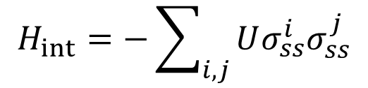



Number-dependent dark states
Can we create special correlated states of photons that are transparent?
Example #1: infinite-range spin interaction
$$H_{int}=−\sum_{i,j}{Uσ_{ss}^{i}σ_{ss}^{j}}$$
$$|e〉$$
$$Ω$$
$$|g〉$$
$$|s〉$$

Slide 29

Number-dependent dark states
Can we create special correlated states of photons that are transparent?
Example #1: infinite-range spin interaction
$$H_{int}=−\sum_{i,j}{Uσ_{ss}^{i}σ_{ss}^{j}}$$
$$|e〉$$
$$Ω$$
$$|g〉$$
$$|s〉$$
$$ω_{eg}$$

Slide 30

Number-dependent dark states
Can we create special correlated states of photons that are transparent?
Example #1: infinite-range spin interaction
$$H_{int}=−\sum_{i,j}{Uσ_{ss}^{i}σ_{ss}^{j}}$$
$$|e〉$$
$$Ω$$
$$U$$
$$|g〉$$
$$|s〉$$
$$ω_{eg}$$

Slide 31


Number-dependent dark states
Can we create special correlated states of photons that are transparent?
Example #1: infinite-range spin interaction
$$H_{int}=−\sum_{i,j}{Uσ_{ss}^{i}σ_{ss}^{j}}$$
$$|e〉$$
$$Ω$$
$$U$$
$$|g〉$$
$$|s〉$$
$$ω_{eg}+U$$
$$ω_{eg}$$
$$+U$$

Slide 32
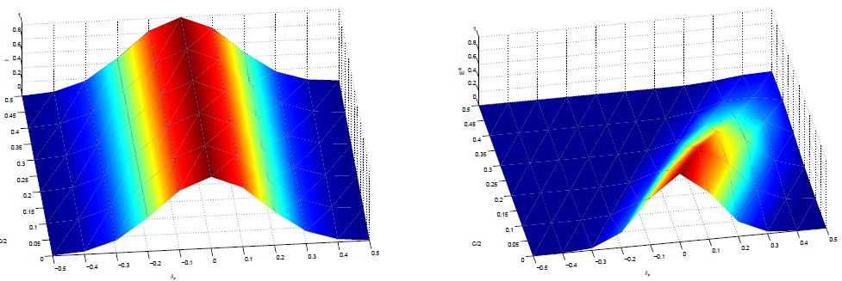




Number-dependent transmission spectra
Transmission spectra
  Two-photon transparency window shifts with interaction strength U
Single-photon
Two-photon
$$U$$
$$U$$
$$ω$$
$$ω$$

Slide 33
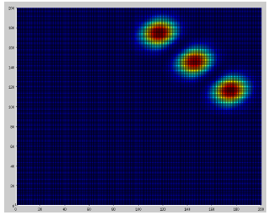
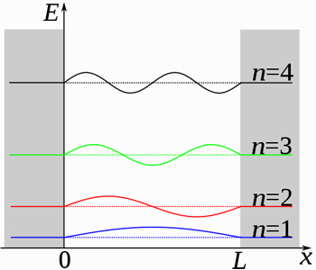
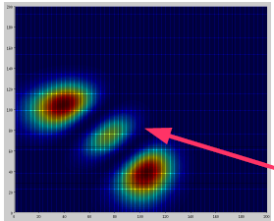
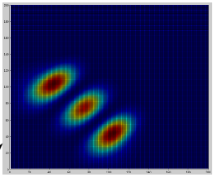




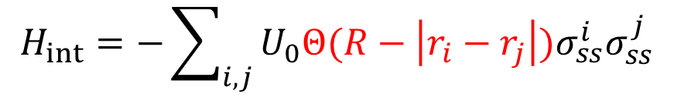
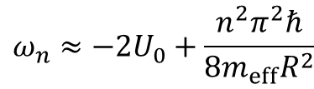


Correlated dark states
Transmit two-photon pulses of a certain frequency and shape
Example #2:
$$H_{int}=−\sum_{i,j}{U_{0}Θ(R−\left|r_{i}−r_{j}\right|)σ_{ss}^{i}σ_{ss}^{j}}$$
$$U(r_{i}−r_{j})$$
$$r_{i}−r_{j}$$
Particle in a box
$$2R$$
$$2R$$
Transparent eigenstates:
Initial $Ψ^{2}(r_{1},r_{2})$
$$ω_{n}≈−{2U}_{0}+\frac{n^{2}π^{2}ℏ}{8m_{eff}R^{2}}$$
w/o int.
w/ int.
Two-photon
“bound state” energies
Relative wavefunctions $ψ(r_{1}−r_{2})$
Exact dynamics
(n=3)

Slide 34
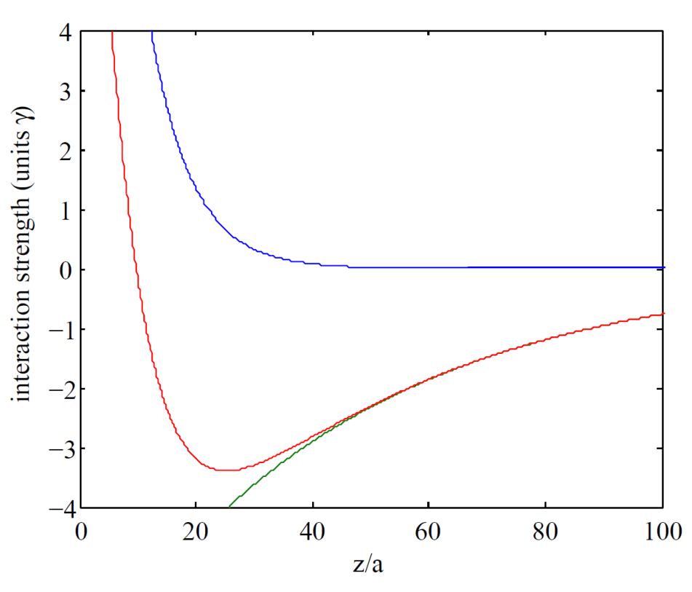
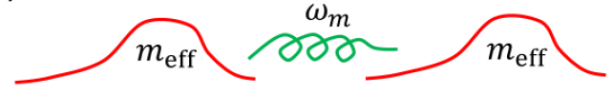
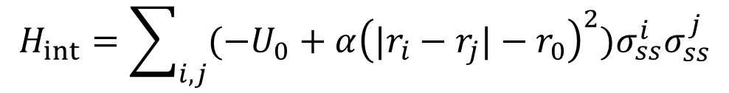

Two-photon molecule
Example #3: locally quadratic interaction potential
Spin-spin interaction
$$H_{int}=\sum_{i,j}{(−U_{0}+α{\left({|r}_{i}−r_{j}|−r_{0}\right)}^{2})σ_{ss}^{i}σ_{ss}^{j}}$$
Intuition:
$$r_{0}$$
Many-body case: try to map onto theories of massive interacting particles

Slide 35
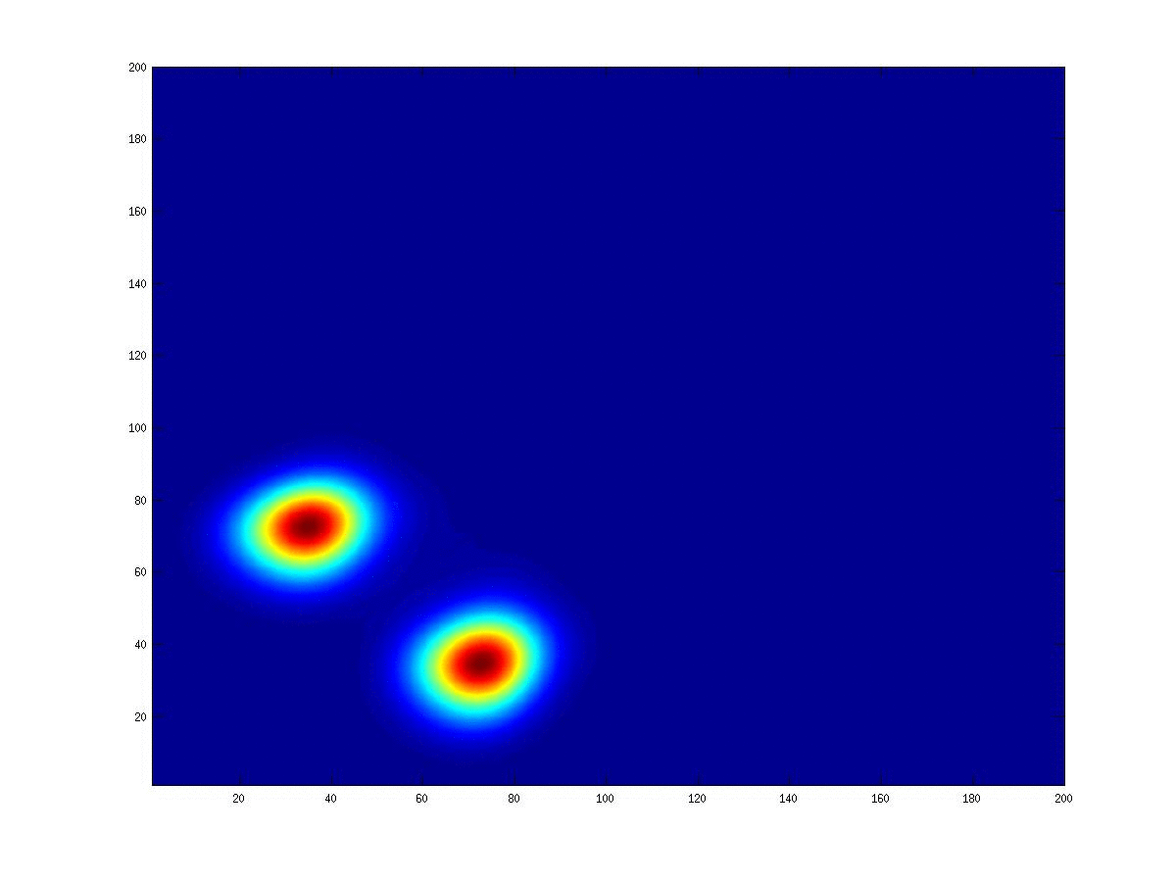




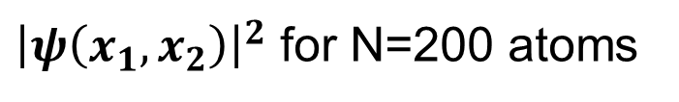

Two-photon molecule
Exact simulation of two-photon wavefunction dynamics:
${\left|ψ\left(x_{1},x_{2}\right)\right|}^{2}$ for N=200 atoms
$$U(x_{rel})$$
$$x_{cm}$$
$$t=0$$
$$x_{rel}$$
$$r_{rel}=0$$

Slide 36

Outlook
New physics by interfacing cold atoms and nanophotonics!
Surface & vacuum forces
Large per-photon forces
Dimensionality & dispersion
Strong atom-photon interactions
New paradigms
Quantum information processing
Single-photon nonlinear optics
Many-body physics
Atom trapping

