Slide 1
Quantum-state-preserving frequency conversion using Bragg scattering in optical fibers
PhD talk
Lasse Mejling^{1*}, Colin J. McKinstrie², Dan S. Cargill³,
Richard O. Moore³, Michael G. Raymer⁴, Karsten Rottwitt¹
¹ DTU Fotonik
² Bell Labs, Alcatel-Lucent
³ New Jersey Institute of Technology
⁴ University of Oregon
* lman@fotonik.dtu.dk

Slide 2
Outline
Introduction
Low-conversion Bragg scattering without nonlinear phase-modulation
Low-conversion Bragg scattering with nonlinear phase-modulation
High-conversion Bragg scattering without nonlinear phase-modulation
Conclusion
Add Presentation Title in Footer via ”Insert”; ”Header & Footer”

Slide 3


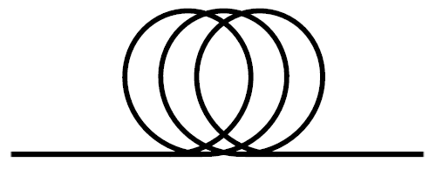

The pain
Quantum key distribution offers unconditionally secure cryptography
To beat quantum we have to go quantum!
Measuring destroys quantum states
Quantum memories: 400 nm-700 nm
States from quantum memories 100 times too wide
Optical fibers: 1310 nm or 1550 nm
Photon detectors: 600 nm-700 nm
Need to frequency convert and reshape while preserving the other quantum properties
Optical fiber
Quantum memory
Photon detector
Alice
Bob

Slide 4
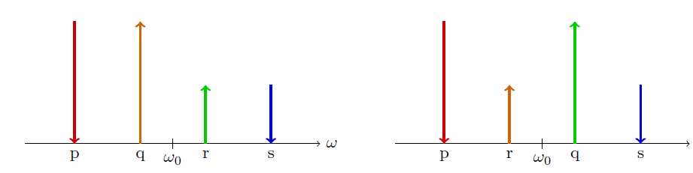
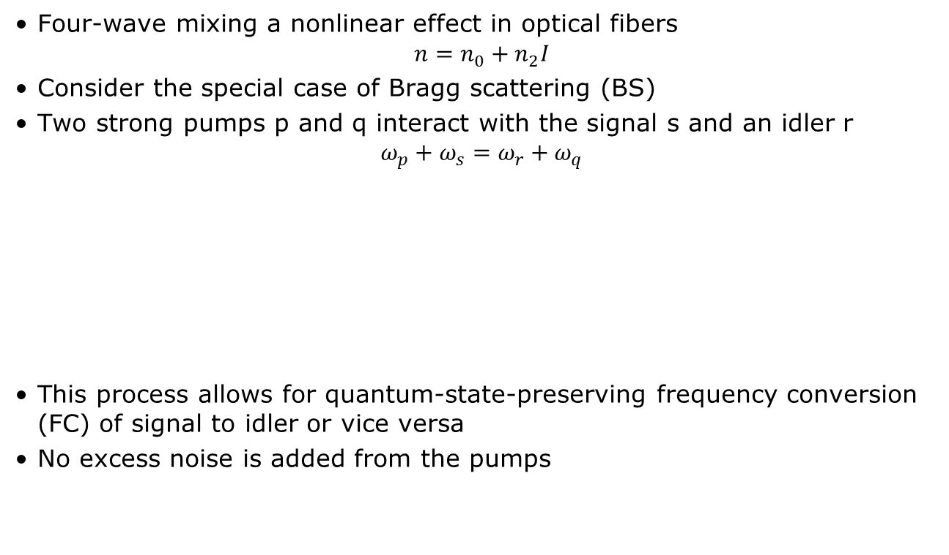
The solution
Four-wave mixing a nonlinear effect in optical fibers
$n=n_{0}+n_{2}I$
Consider the special case of Bragg scattering (BS)
Two strong pumps p and q interact with the signal s and an idler r
$ω_{p}+ω_{s}=ω_{r}+ω_{q}$
This process allows for quantum-state-preserving frequency conversion (FC) of signal to idler or vice versa
No excess noise is added from the pumps

Slide 5
Outline
Introduction
Low-conversion Bragg scattering without nonlinear phase-modulation
Low-conversion Bragg scattering with nonlinear phase-modulation
High-conversion Bragg scattering without nonlinear phase-modulation
Conclusion
Add Presentation Title in Footer via ”Insert”; ”Header & Footer”

Slide 6
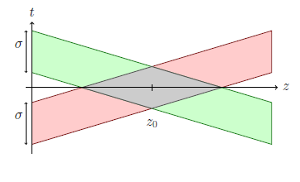
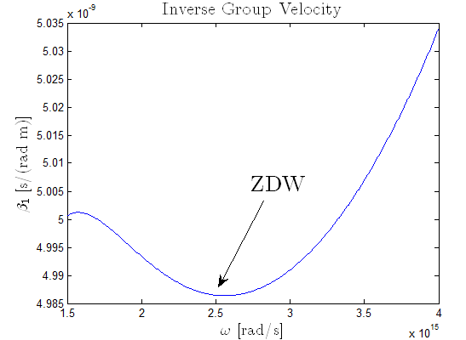
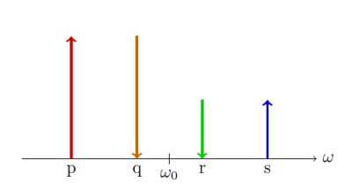
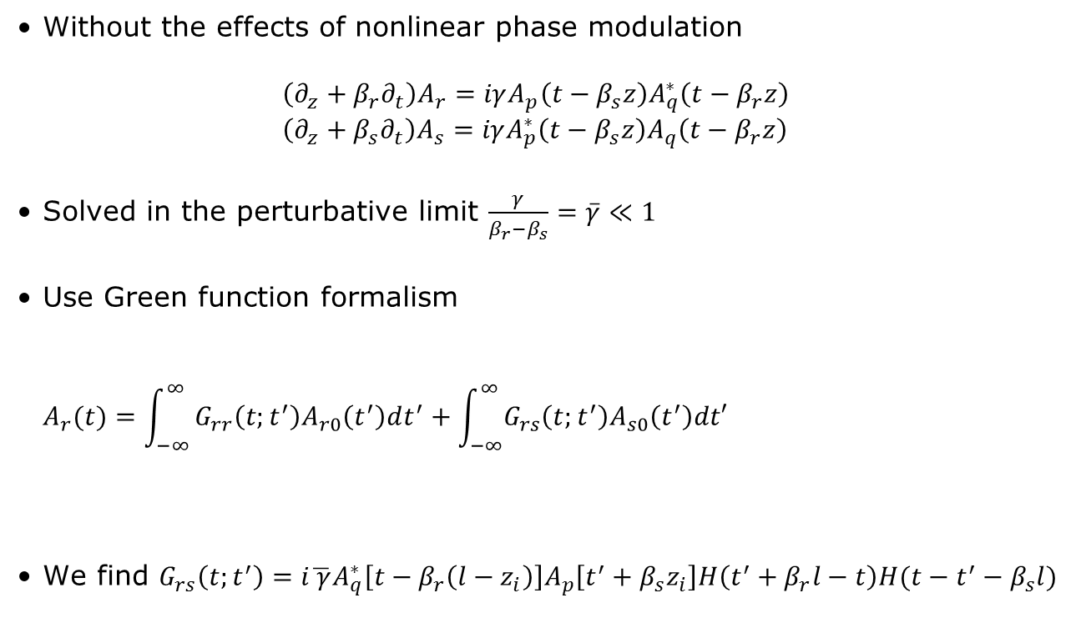
Low-conversion no nonlinear phase modulation I
Without the effects of nonlinear phase modulation
$\left(∂_{z}+β_{r}∂_{t}\right)A_{r}=iγA_{p}\left(t−β_{s}z\right)A_{q}^{∗}\left(t−β_{r}z\right)$
$\left(∂_{z}+β_{s}∂_{t}\right)A_{s}=iγA_{p}^{∗}\left(t−β_{s}z\right)A_{q}\left(t−β_{r}z\right)$
Solved in the perturbative limit $\frac{γ}{β_{r}−β_{s}}=\overline{γ}≪1$
Use Green function formalism
$A_{r}(t)=\int_{−∞}^{∞}{G_{rr}\left(t;t^{′}\right)A_{r0}\left(t^{′}\right)dt^{′}+\int_{−∞}^{∞}{G_{rs}\left(t;t^{′}\right)A_{s0}\left(t^{′}\right)dt′}}$
We find $G_{rs}\left(t;t^{′}\right)=i\overline{ γ}A_{q}^{∗}\left[t−β_{r}\left(l−z_{i}\right)\right]A_{p}\left[t^{′}+β_{s}z_{i}\right]H\left(t^{′}+β_{r}l−t\right)H(t−t^{′}−β_{s}l)$
Output time
Input time
Assumed = 0
Input signal
L. Mejling et al., Optics Express 20, 8367-8396 (2012)

Slide 7
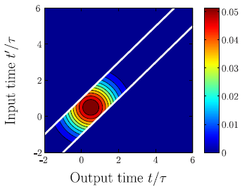
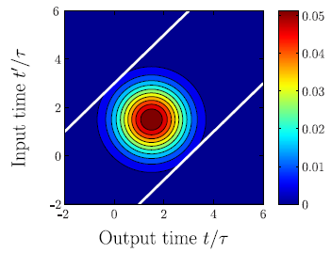
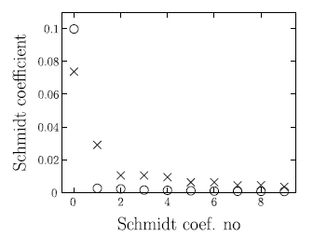
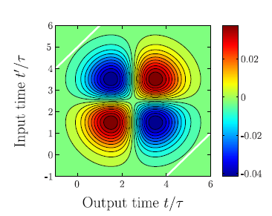

Low-conversion no nonlinear phase modulation II
Green function$G_{rs}\left(t;t^{′}\right)=i\overline{ γ}A_{q}^{∗}\left[t−β_{r}\left(l−z_{i}\right)\right]A_{p}\left[t^{′}+β_{s}z_{i}\right]H\left(t^{′}+β_{r}l−t\right)H\left(t−t^{′}−β_{s}l\right)$
No temporal entanglement if $G_{rs}=v\left(t\right)λ^{\frac{1}{2}}u_{n}^{∗}(t^{′})$
Schmidt decomposition: $G_{rs}\left(t;t^{′}\right)=\sum_{n=0}^{∞}{v_{n}\left(t\right){λ_{n}^{}}^{\frac{1}{2}}u_{n}^{∗}\left(t^{′}\right)}$
Free of temporal entanglement for sufficiently long fibers
Reshaping of higher-order modes possible
Long fiber
βl/τ =1
βl/τ =3
L. Mejling et al., Optics Express 20, 8367-8396 (2012)

Slide 8
Outline
Introduction
Low-conversion Bragg scattering without nonlinear phase-modulation
Low-conversion Bragg scattering with nonlinear phase-modulation
High-conversion Bragg scattering without nonlinear phase-modulation
Conclusion
Add Presentation Title in Footer via ”Insert”; ”Header & Footer”

Slide 9
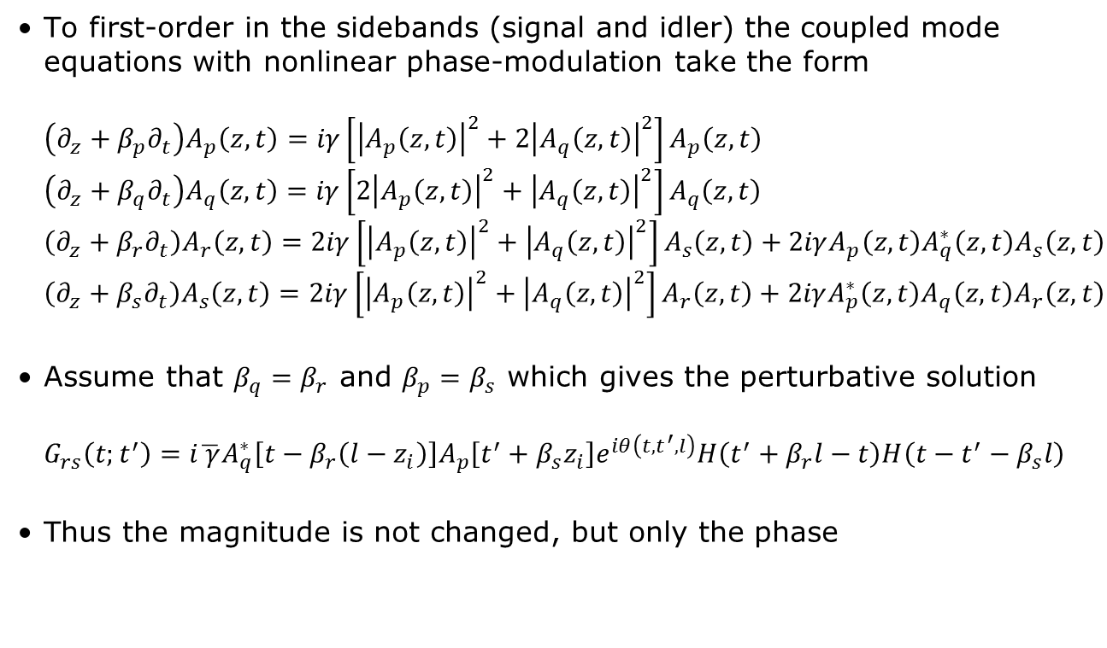
Low-conversion with nonlinear phase modulation I
To first-order in the sidebands (signal and idler) the coupled mode equations with nonlinear phase-modulation take the form
$\left(∂_{z}+β_{p}∂_{t}\right)A_{p}\left(z,t\right)=iγ\left[{\left|A_{p}\left(z,t\right)\right|}^{2}+2{\left|A_{q}\left(z,t\right)\right|}^{2}\right]A_{p}\left(z,t\right)$
$\left(∂_{z}+β_{q}∂_{t}\right)A_{q}\left(z,t\right)=iγ\left[{2\left|A_{p}\left(z,t\right)\right|}^{2}+{\left|A_{q}\left(z,t\right)\right|}^{2}\right]A_{q}\left(z,t\right)$
$\left(∂_{z}+β_{r}∂_{t}\right)A_{r}\left(z,t\right)=2iγ\left[{\left|A_{p}\left(z,t\right)\right|}^{2}+{\left|A_{q}\left(z,t\right)\right|}^{2}\right]A_{s}\left(z,t\right)+2iγA_{p}^{}\left(z,t\right)A_{q}^{∗}\left(z,t\right)A_{s}\left(z,t\right)$
$\left(∂_{z}+β_{s}∂_{t}\right)A_{s}\left(z,t\right)=2iγ\left[{\left|A_{p}\left(z,t\right)\right|}^{2}+{\left|A_{q}\left(z,t\right)\right|}^{2}\right]A_{r}\left(z,t\right)+2iγA_{p}^{∗}\left(z,t\right)A_{q}^{}\left(z,t\right)A_{r}\left(z,t\right)$
Assume that $β_{q}=β_{r}$ and $β_{p}=β_{s}$ which gives the perturbative solution
$G_{rs}\left(t;t^{′}\right)=i\overline{ γ}A_{q}^{∗}\left[t−β_{r}\left(l−z_{i}\right)\right]A_{p}\left[t^{′}+β_{s}z_{i}\right]e^{iθ\left(t,t^{′},l\right)}H\left(t^{′}+β_{r}l−t\right)H\left(t−t^{′}−β_{s}l\right)$
Thus the magnitude is not changed, but only the phase
L. Mejling et al., To be submitted to Optics Express (2012)

Slide 10
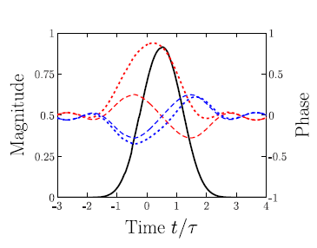
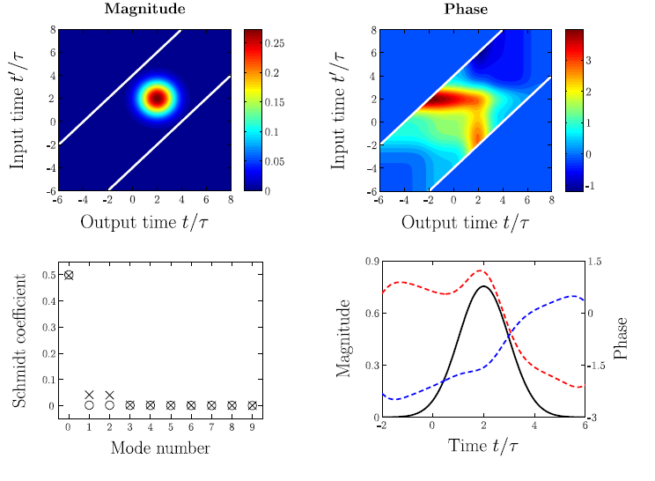
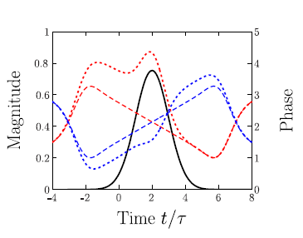
Low-conversion with nonlinear phase modulation II
βl/τ =1
Only approximately separable with NPM
Pre-chirping the pumps reduce the phase shift
βl/τ =4
With NPM
L. Mejling et al., To be submitted to Optics Express (2012)

Slide 11
Outline
Introduction
Low-conversion Bragg scattering without nonlinear phase-modulation
Low-conversion Bragg scattering with nonlinear phase-modulation
High-conversion Bragg scattering without nonlinear phase-modulation
Conclusion
Add Presentation Title in Footer via ”Insert”; ”Header & Footer”

Slide 12
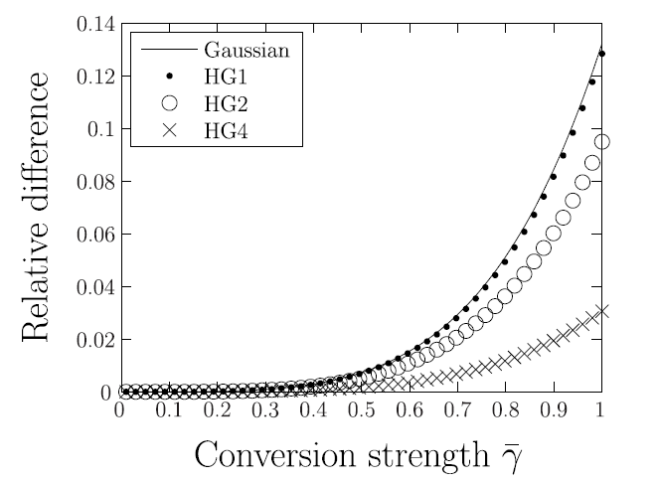
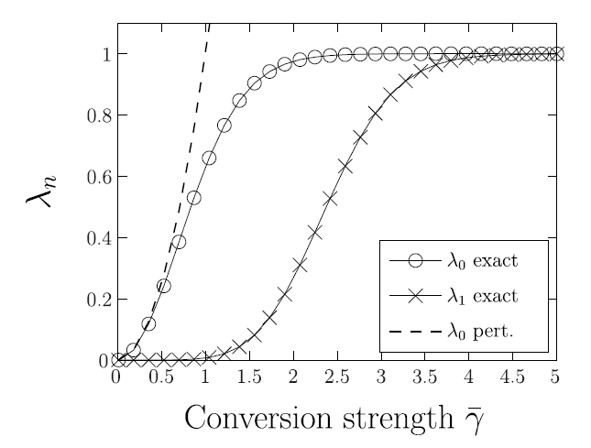

High-conversion without nonlinear phase modulation
The coupled mode equations are solvable analytically without NPM
$G_{rs}\left(t;t^{′}\right)=i\overline{γ}A_{q}^{∗}\left(t−β_{r}l\right)J_{0}\left\{2\overline{γ}{\left[ξ\left(t;t^{′}\right)η\left(t;t^{′}\right)\right]}^{\frac{1}{2}}\right\}A_{p}\left(t^{′}\right)H\left(t^{′}+β_{r}l−t\right)H\left(t−t^{′}−β_{s}l\right)$
where $ξ\left(t;t^{′}\right)=\int_{t−β_{r}l}^{t′}{{\left|A_{q}\left(s\right)\right|}^{2}ds}$ and $η\left(t;t^{′}\right)=\int_{t′}^{t−β_{s}l}{{\left|A_{p}\left(s\right)\right|}^{2}ds}$
C. J. McKinstrie et al., Physical Review A 85, 053829 (2012)

Slide 13
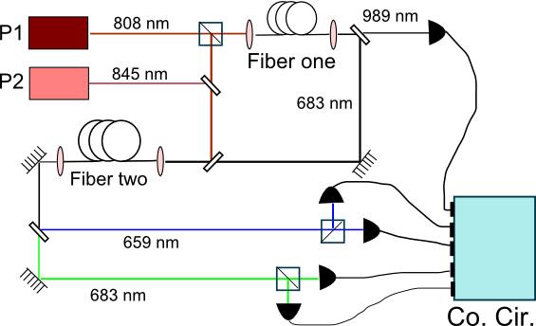
Experiments
(a) Gnauck demonstrated FC of a
classical signal, with 99% conversion
efficiency. The output idler had a 3-dB
higher SNR.
(b) McGuinness demonstrated single-
photon FC, with 28% conversion efficiency.
Quantumness is measured by second-order correlation coefficient G⁽²⁾. Classical signals have G⁽²⁾ ≥ 1, whereas perfect photon pairs have G⁽²⁾ = 0.
Correlation counting showed that G₆₈₃ = 0.21, G₆₅₉ = 0.19.
[A. Gnauck, Opt. Express 14, 8989 (2006); H. McGuinness, Phys. Rev. Lett. 105, 093604 (2010).]

Slide 14
Conclusion and outlook
BS allows for arbitrary reshaping of the input and FC over a wide range, while preserving other quantum properties
Paper on low-conversion BS with NPM soon to be submitted
Long paper on high-conversion BS in the process
Further experimental verifications

Slide 15
THANK YOU!

