Slide 1
Optomechanical cooling
... a story of membranes
Andreas Næsby (NBI)

Slide 2
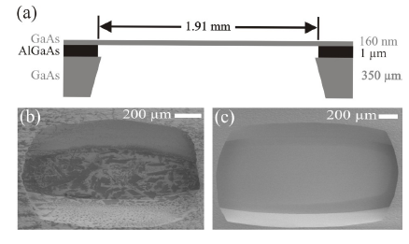
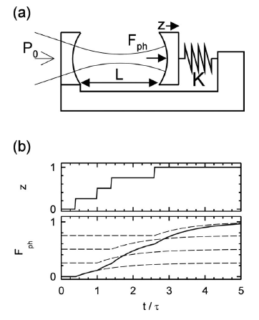
GaAs nanomembrane
GaAs
160 nm
AlGaAs
1 μm
1.36 mm
GaAs
350 μm
1.91 mm
160 nm
J. Liu et al, APL. 99, 243102 (2011).
Membrane as a mirror in optomechanical cavity

Slide 3
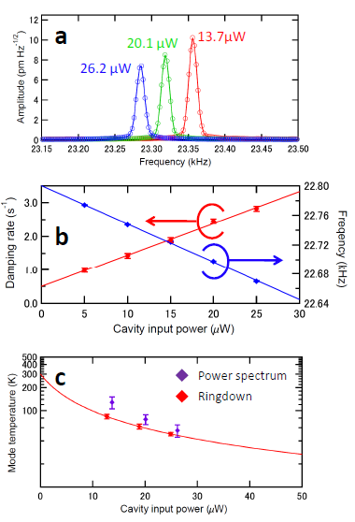
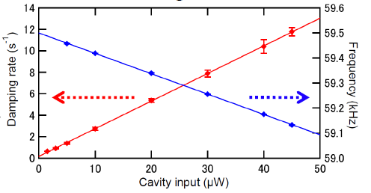
Cooling Results
Mode | Frequency (kHz) | Cooling factor | Effective temperature (K)
(2,1) | 23.4 | 10.8 | 28
(3,2) | 45.5 | 10.3 | 29
(4,1) | 47.5 | 12.5 | 24
(4,3) | 59.5 | 74.9 | 4.0
Usami et al., Nat. Phys. (2011)

Slide 4





Cooling
Equation of motion
Time domain:
S domain:
Light-induced force
Light-induced force
Delay
S domain
Time domain
Metzger, C. et al. PRB. 78, 035309 (2008).

Slide 5
Cooling mechanism determined by delay time
Radiation pressure?
Photothermal?
Deformation potential coupling?
Delay time

Slide 6
Deformation potential cooling
Thermal stress pr. photon
eV
Def. pot. effect is stronger
pr. photon
Deformation potential induced stress pr. photon

Slide 7
So why did it not dominate?
Total electronic/def. pot. stress
Total thermal stress

Slide 8
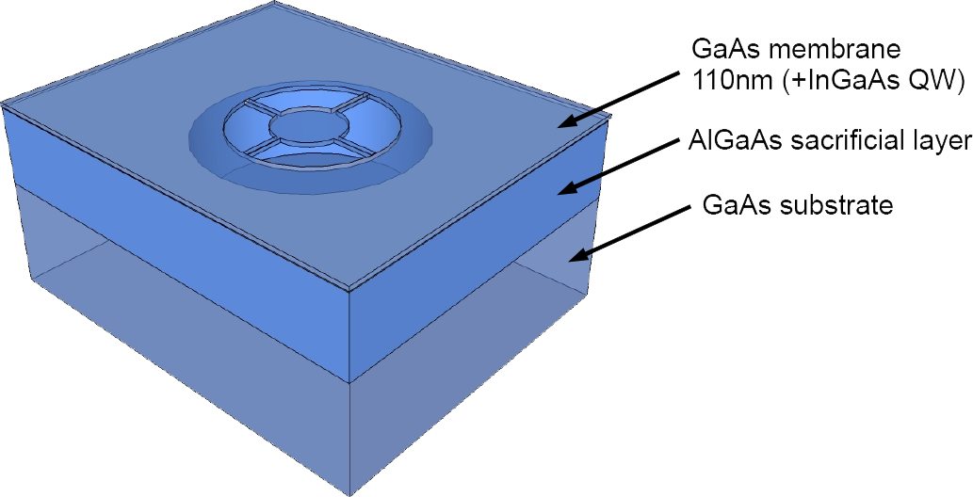
Micromembranes @ ETH
Fabricated at the Quantum Photonics group at ETH
~5µm
Differential interference contrast microscopy picture
Sánchez, ‘12

Slide 9
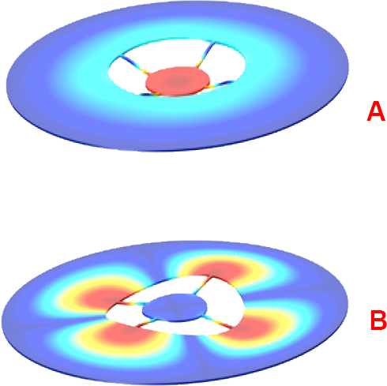
Vibrational behaviour
FEM examples
Measurements
6 MHz
8.5 MHz

Slide 10
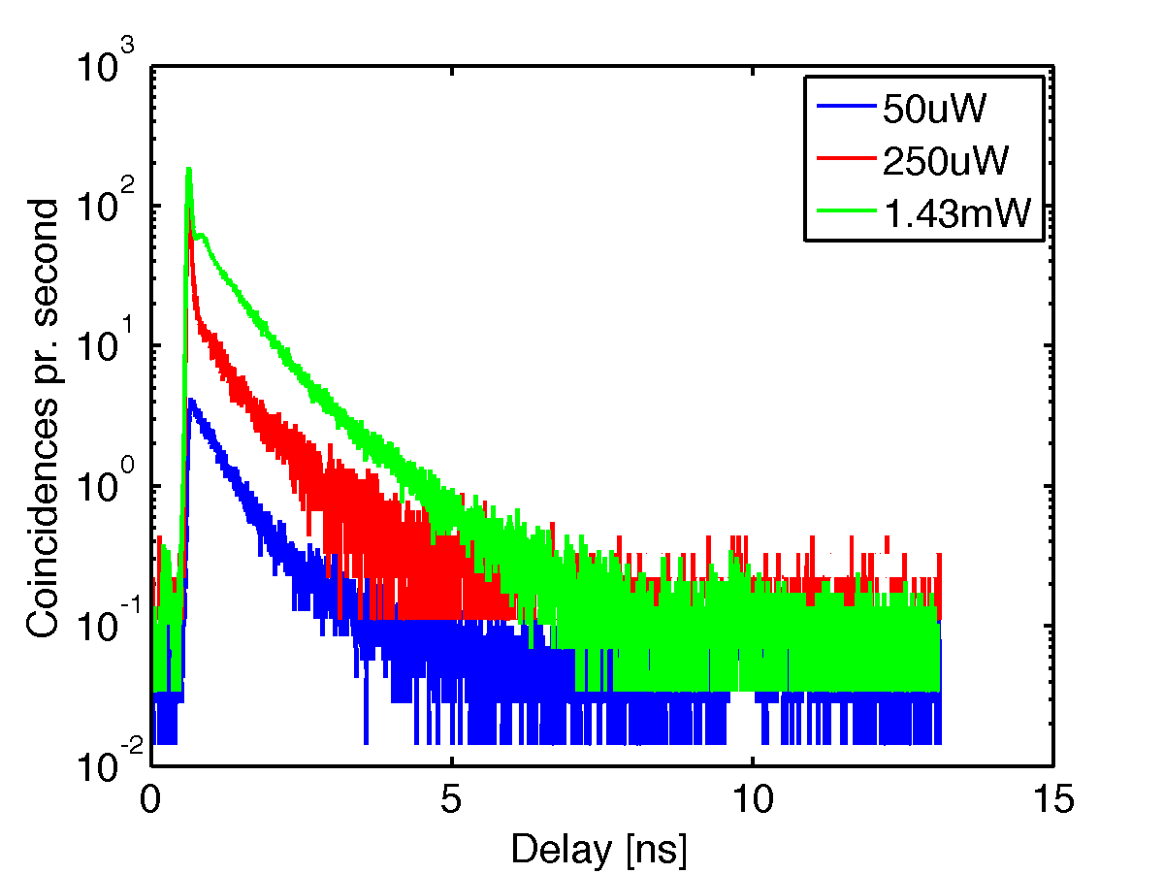
Time resolved Photoluminescence
Fast decay

Slide 11
Proposed structure
Coupled QW

Slide 12
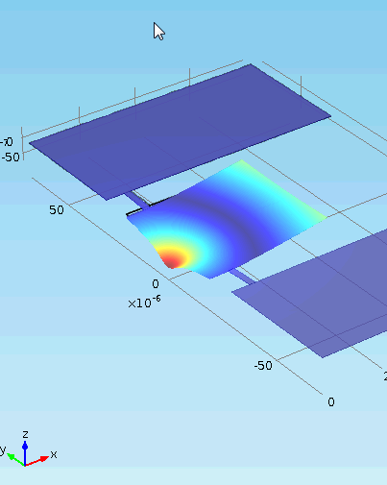
Tunable coupling

Slide 13
Members and collaborators
GaAs nanomembrane project
NBI
Lodahl Group (moved to NBI)
Eugene S. Polzik
Andreas Naesby
Koji Usami
Tolga Bagci
Peter Lodahl
Søren Stobbe
Jin Liu
ETH Zürich QPG
QUEST Hannover
Atac Imamoglu
Javier M. Sánchez
Emre Togan
et al.
Klemens Hammerer
André Xuereb

