Slide 1
Four wave mixing in submicron waveguides

Slide 2



Basis
Material with 3rd order nonlinearity – χ⁽³⁾
pump
Signal
waveguide
Pump
Idler
signal
idler
Energy from the pump is transferred to the signal and idler
Refractive index is dependent on the light intensity
nonlinear refractive index
Propagation constant is also dependent on light intensity (power)
nonlinear coefficient
Nonlinear phase shift is generated during propagation
Notes:
What is four wave mixing? The simplest case of FWM is simple generation of third wave when we input two different waves into nonlinear medium. Depending on wavelength difference between two entering waves third wave will be generated on the other side of the pump wave, symmetrically with respect of the signal wave. How this happened? Basically energy from strong pump is transferred to the signal that would be amplified and a new idler wave that will be generated simultaneously. In this case two pump photons are destroyed and their energy appears in two new photons.
What is the physics below? Refractive index of the medium is dependent on the light intensity. This means that optical wave passing through the medium is changing conditions of own propagation. Since the refractive index is related to propagation constant, prop.const. is also intensity dependent. This can introduce nonlinear phase shift dependent on input power during light propagation.

Slide 3
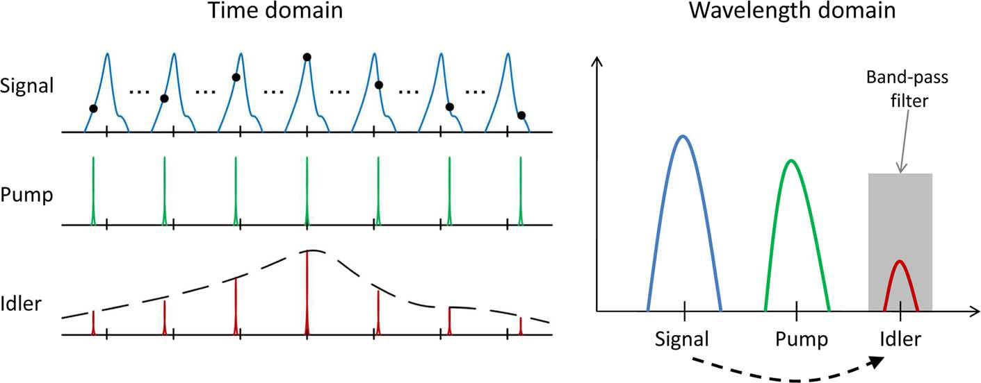
Applications
Wavelength conversion
CW Pump
Idler
Possible to transfer data from signal to the idler wave at the new wavelength
Nonlinear medium
Signal Channel
Optical filter
Optical sampling
Sampling of high speed signals beyond the limits of electronics
Short samplings pulses act as the pump ⇒ Idler pulse width comparable to pump pulses
J. V. Erps et al., J. Lightwave Technol. 21 (2010) 209-15.

Slide 4
Different nonlinear media
Waveguide
Advantages
Problems
Extended length
n₂ ~ 10⁻²⁰ m²/W
Stimulated Brillouin scattering
SiO₂ highly nonlinear fiber
Low losses
n₂ ~ 10⁻¹⁸ m²/W
Strong confinement
Length is shortened
Two photon absorption
Increased losses
Silicon waveguides
Separate engineering of D and γ
Slow light regime
Photonic crystals waveguides
Fabrication
n₂ ~ 10⁻¹⁷ m²/W
No two photon absorption
III-V waveguides
Three photon absorption

Slide 5
Outline
Motivation
Phase – matching
Characterization needs
  Dispersion characterization
  Nonlinear characterization
  Conversion bandwidth

Slide 6
Phase matching
pump
CE
signal
idler
Conversion efficiency:
Depends on phase matching parameter:
Linear phase mismatch:
Therefore essential to be able to measure dispersion over a broad bandwidth as well the nonlinear coefficient γ
Notes:
Parametric interactions are strongest when the process is phasematched.

Slide 7
Dispersion characterisation
Low coherence interferometer
being implemented
Free space Mach-Zehnder interferometer structure
SOA used as broadband source
Good method to characterise dispersion over broad bandwidth
As required for phase matching evaluation

Slide 8
Nonlinear coefficient characterisation
EDFA
waveguide under test
OSA
CW
Att.
PWM
CW
If the waveguide dispersion can be neglected (⇒ small wavelength separation between lasers)
with
P_{in} is the sum of the power of the 2 lasers at the waveguide input
Measure I₀ , I₁ , versus P_{in}
Retrieve γ
A. Boskovic et al., Opt. Lett. 21 (1996) 1966-8.

Slide 9
Nonlinear coefficient measurement
w
Output of the chip
Si
h
SiO₂
substrate
h = 340 nm
w = 500 nm
Facet loss [dB] | 7.82 (TE) | 7.76 (TM)
Propagation loss [dB/cm] | 2.66 | 1.95
γ [1/Wm] | 151.56 | 145.91
Calculation:
Good agreement with theoretical calculation
Notes:
Discuss about linear fit. It is not perfectly linear because fwm efficiency was not that big?

Slide 10
Conversion efficiency
Different models used by groups working in the field
No loss
No pump depletion
No nonlinear phase matching
No pump depletion
N. Shibata et al., J. Quantum Electron. 23 (1987) 1205-10.
R.H. Stolen et al., J. Quantum Electron.18 (1982) 1062-71
Modified pump power
No pump depletion
Losses taken into account
No pump depletion
M.E. Heidari et al., Opt. Express 17 (2009) 18340-53.
K. Wang et al., Opt. Lett. 37 (2012) 1331-3.
Notes:
It is important to know what is CE bandwidth if we want to demonstrate FWM in nanowires. In order to predict conversion efficiency different models are used by groups working in the field.
Besides those analytical models there is also numerical model, which is exact, but than we are loosing sense of physics. It is also important to mention that model developed by Shibata is in very good agreement with numerical calculations.

Slide 11
Conversion efficiency bandwidth
Example:
w
h = 205 nm
w = 900 nm
Si
h
SiO₂
substrate
Exact solution obtained using numerical method
Bandwidth for Stolen L_{eff} is overestimated
Maximum conversion efficiency for Stolen model is overestimated – model does not include loses
Bandwidth for Shibata model and Modified Stolen model are very close

Slide 12
Conclusions
Conversion efficiency and the FWM bandwidth can be further increased in waveguides.
Phase matched nonlinear processes like FWM benefit from the use of engineered waveguides through dispersion engineering, which ensures phase matching over a large bandwidth.
Using FWM in new materials photonic waveguides should continue to provide unique nonlinear optical functionality at even lower power levels.
Thank you ☺

